Slide 1
Welcome to Georgia College

Slide 2
In this module you will learn how to access Unify, Degree Works, LiveText, and Georgia View. You will also learn how to create a DegreeWorks planner and registering for classes.

Slide 3
How to use Unify

Slide 4
Unify
Step 1. Please visit unify.gscu.edu and follow the “mypassword” tab

Slide 5
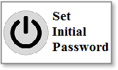
Unify
Step 2. Set Initial Password

Slide 6
Unify
Your Initial Password cannot contain:
Any portion of your name
Special characters

Slide 7
Unify
Your Initial Password must contain:
Is at least 10 characters long
1 upper case
1 lower case
And a number

Slide 8
Unify
Submit your initial password

Slide 9
Unify
After submitting your initial password, there will be a box that tells you the next step is to enroll.
DO NOT ENROLL HERE !!!

Slide 10
Unify
Return to unify.gcsu.edu
Select the password tab
Follow the link SET or Change Enrollment icon.

Slide 11
Unify
Enter your email address and initial password
Answer the 5 Security Questions
Select Enroll

Slide 12
Unify
Did you receive a message confirming successful enrollment?
Yes or No

Slide 13
Unify
Congratulations! You are enrolled in Unify.

Slide 14
Unify
For additional assistance, please contact Serv at (478) 445-7378.

Slide 15
Unify
Once successfully enrolled, your Bobcats’ email password will be updated to match your Unify password.

Slide 16
Unify
After accessing Unify, follow the link on the Office 365 Tab (or the PAWS tab, if that is what you need) and you will be able to download Office 365 for free!

Slide 17
Unify
Please contact SERV (478 445-7378) if you have any issues.

Slide 18
1. True or False: In order to set your initial Unify Password, you will need the following information: GCID, Georgia College Email Address, Date of Birth, and Shape Match
True or False

Slide 19
That is Correct!
Continue the module

Slide 20
Sorry that is incorrect!
Try again

Slide 21
How to Access Degree Works
​Student Log-in Instructions
Log in to PAWS
Select the Student & Financial Aid link
Select Student Records
Follow the DegreeWorks link
Select the Worksheet tab to view your information

Slide 22
How to Create a Planner in DegreeWorks
What is the Planner?
A new feature in DegreeWorks that will allow you to make a long-term plan for degree completion and verify that the courses you included on your plan will fulfill your degree requirements

Slide 23
2. True or False: After the initial password creation, you will need your password and GCID to login into Unify?
True or False

Slide 24
Sorry!
Please try again!

Slide 25
Congratulations!
Please continue the Module

Slide 26
REVIEW: HOW TO LOGIN INTO DEGREEWORKS
Log in to PAWS
Select the Student & Financial Aid link
Select Student Records
Follow the DegreeWorks link
Select the Worksheet tab to view your information

Slide 27
Why should you use the Planner?
It will help you stay on track to graduate within your desired time range.
It will help you plan for registration for upcoming semesters.
It will help you avoid last minute issues when you apply for graduation.
It will help you better understand your remaining degree requirements.
It will help you prepare for your advising appointments with your academic advisor.

Slide 28
To Begin Using the Planner …
Log in to DegreeWorks
For more information on getting started in DegreeWorks, go to http://www.gcsu.edu/registrar/degreeworks.htm and review the introductory tutorial.
Select the Planner Tab at the top of the screen.

Slide 29
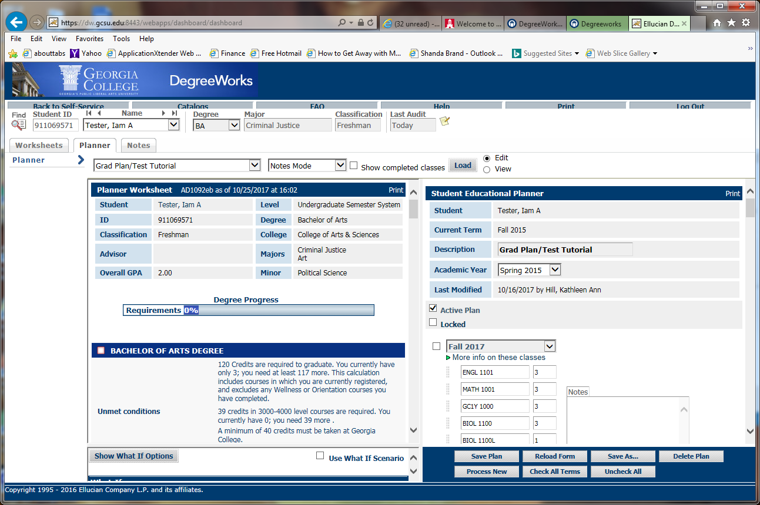
The Planner is divided into two parts. Your current worksheet appears on the left side of the screen. The Planner appears on the right. You can increase or decrease each side by dragging the gray bar in the middle of the screen to the left or the right.
worksheet
Planner

Slide 30
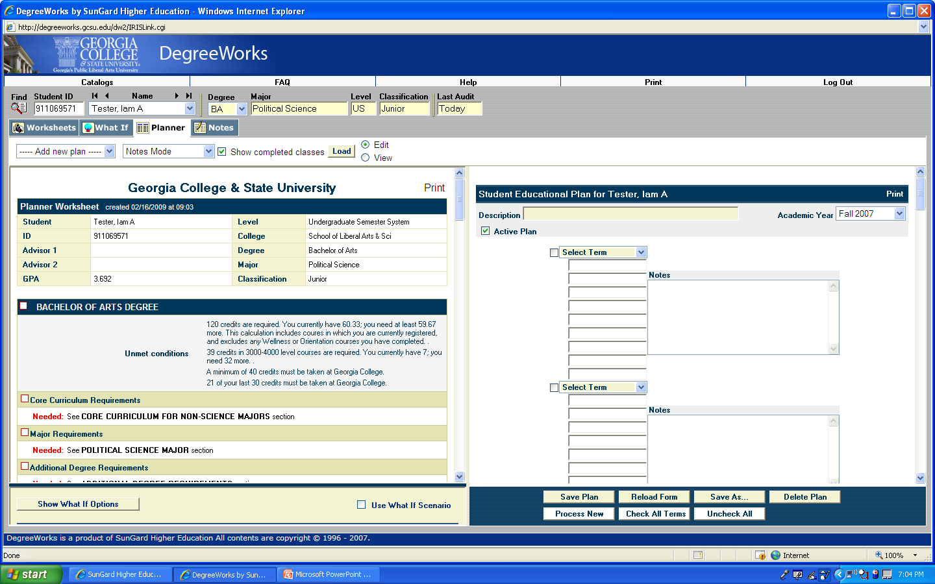
If you do not have an existing plan, this drop-down menu will automatically set to “add new plan.” (If you have one or more saved plans, your plans will be listed here along with an “add new plan” option. Use the “load” button to load the one you want to view.)

Slide 31
This drop-down menu controls the way you view the planner. In Notes mode, the plan will be formatted in this way, and will include a place to add notes for each semester.

Slide 32
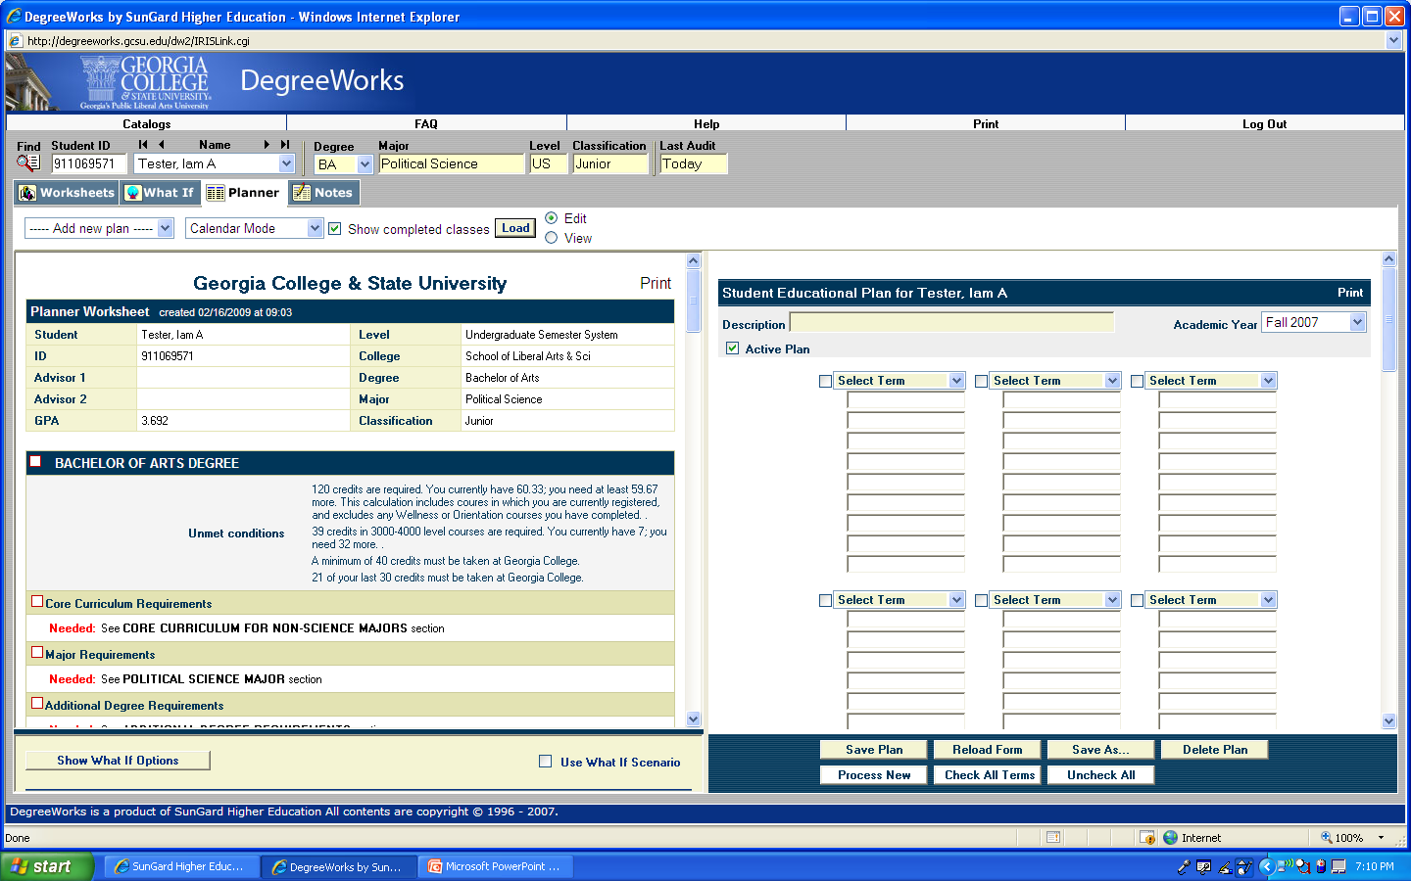
In Calendar mode, the plan will be formatted in this way. You will not be able to add notes for each semester, but you can view more semesters at one time.

Slide 33
To switch between the calendar and the notes mode, you will need to select your preference from this drop down box, and then use the “load” button. (Be sure to save before switching modes if you’ve already entered information on your plan.)

Slide 34
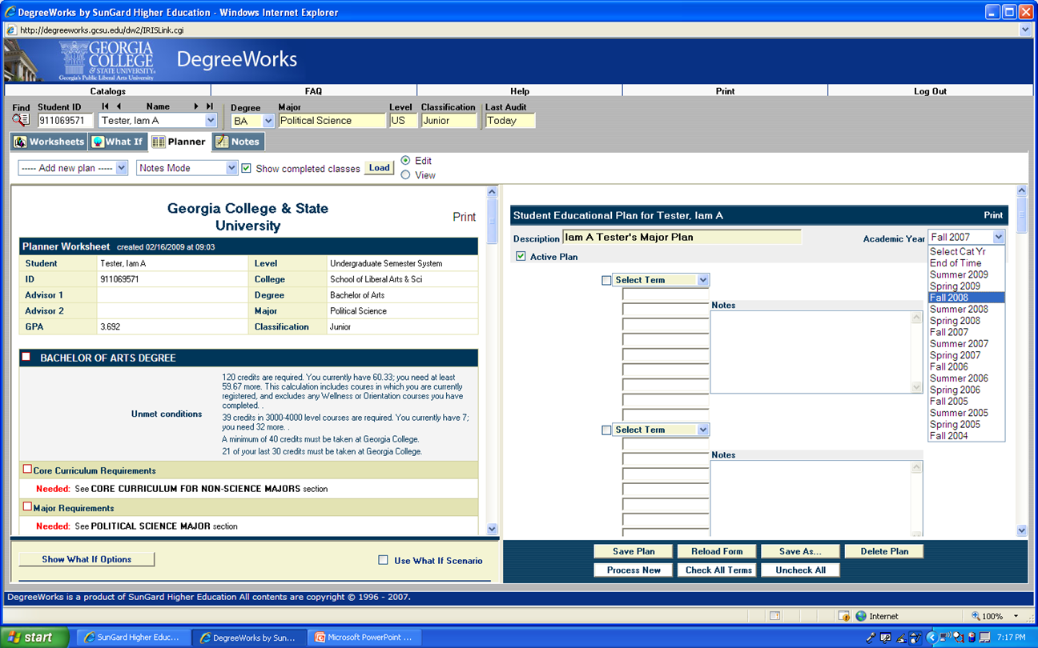
Use this drop down box to enter the catalog you are using. To begin your plan, pick your preferred view. Then, type a description for the plan.

Slide 35
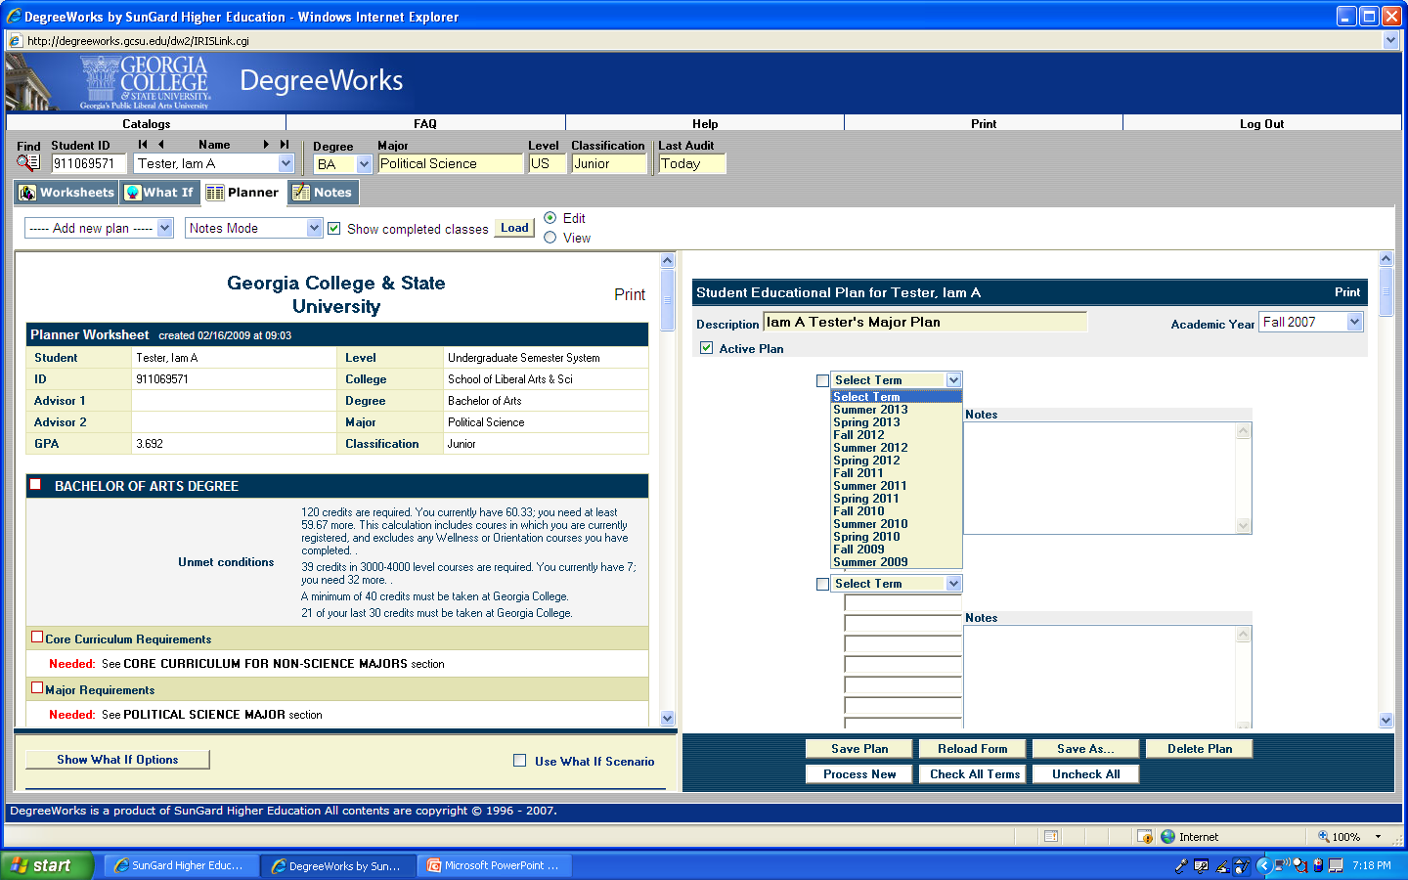
Use these drop down boxes to label each future term in which you plan to enroll. (Remember that Maymester is part of the Summer term.)

Slide 36
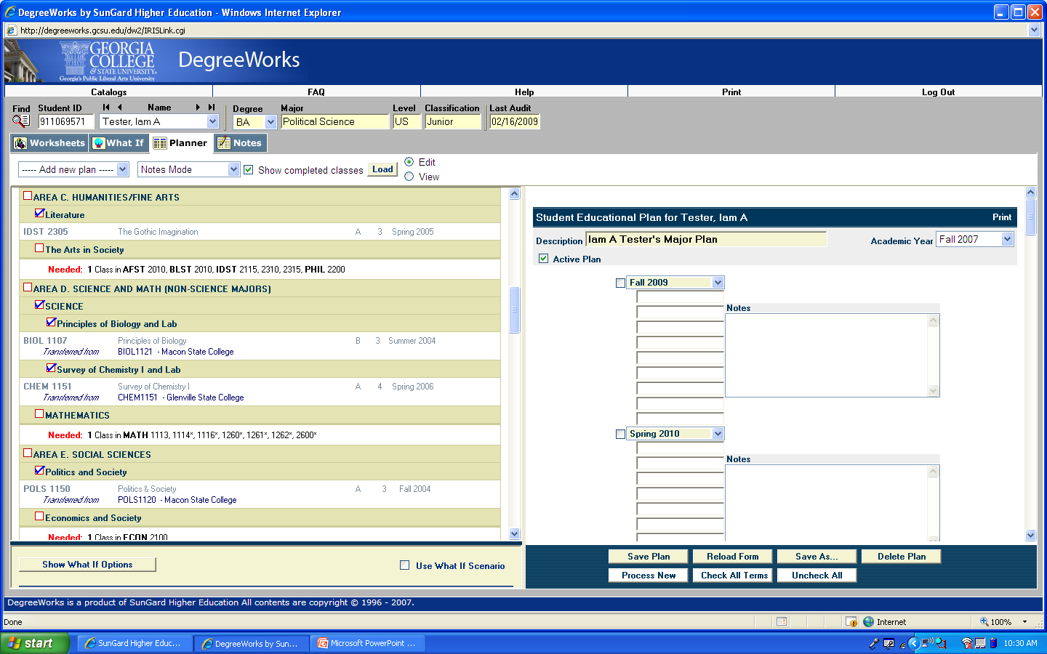
Next, scan your worksheet using the scroll bar in the middle of the page. Look for any requirements that are marked as “Needed.”

Slide 37
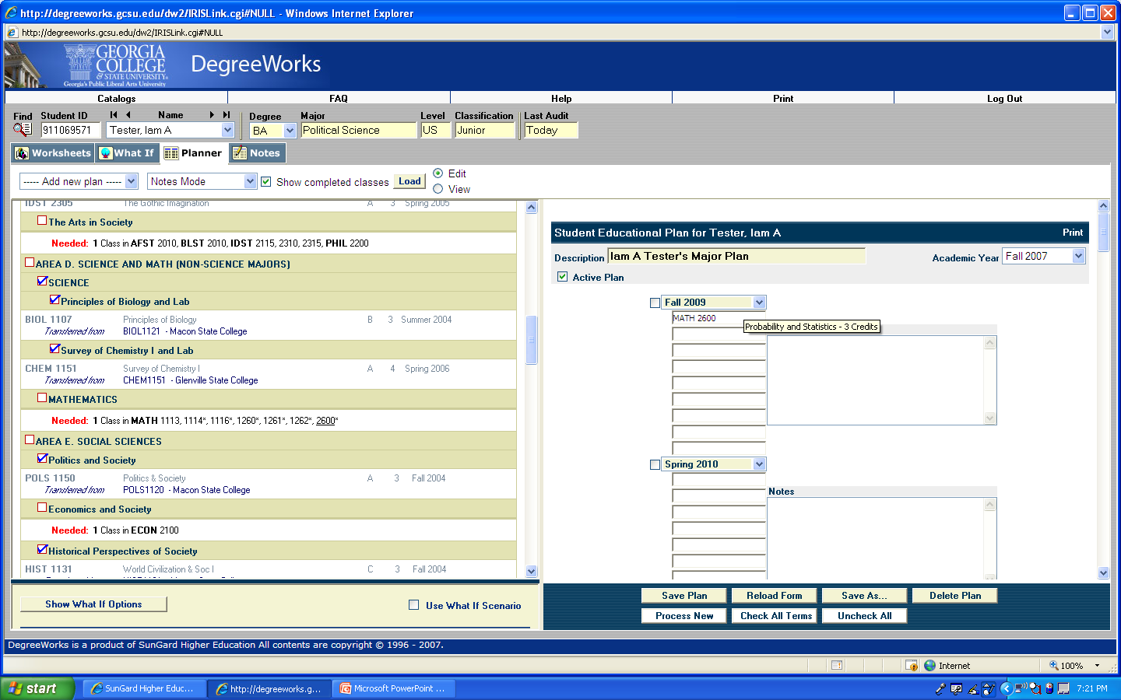
Drag and drop needed courses from your worksheet to the term during which you plan
to take that course. You can also type courses directly into the Planner fields. To do so,
use the course prefix (e.g., MATH), a space, and the four digit course number.

Slide 38
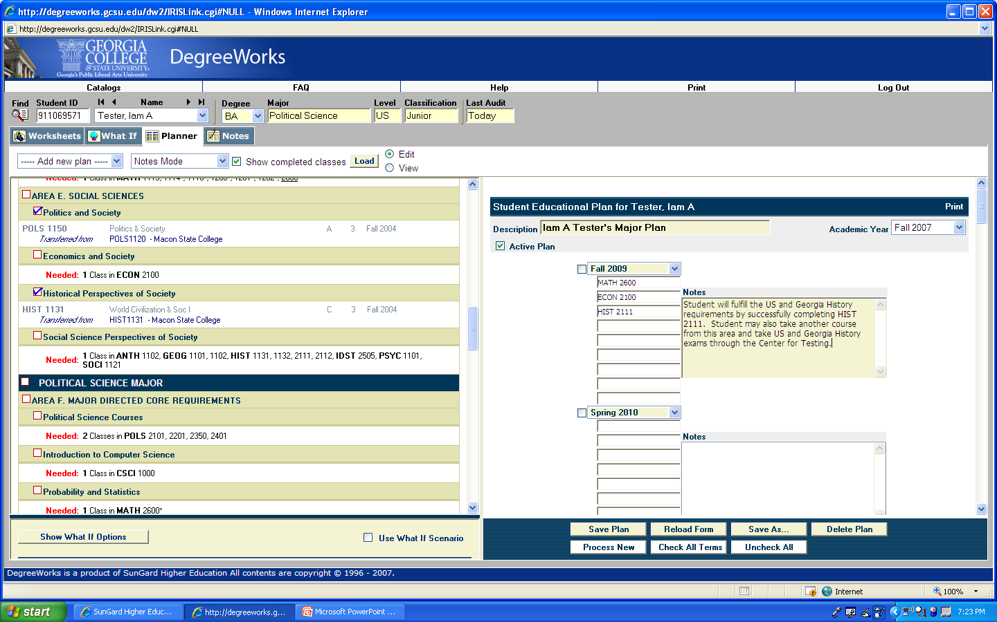
Add any pertinent notes in the notes field.

Slide 39
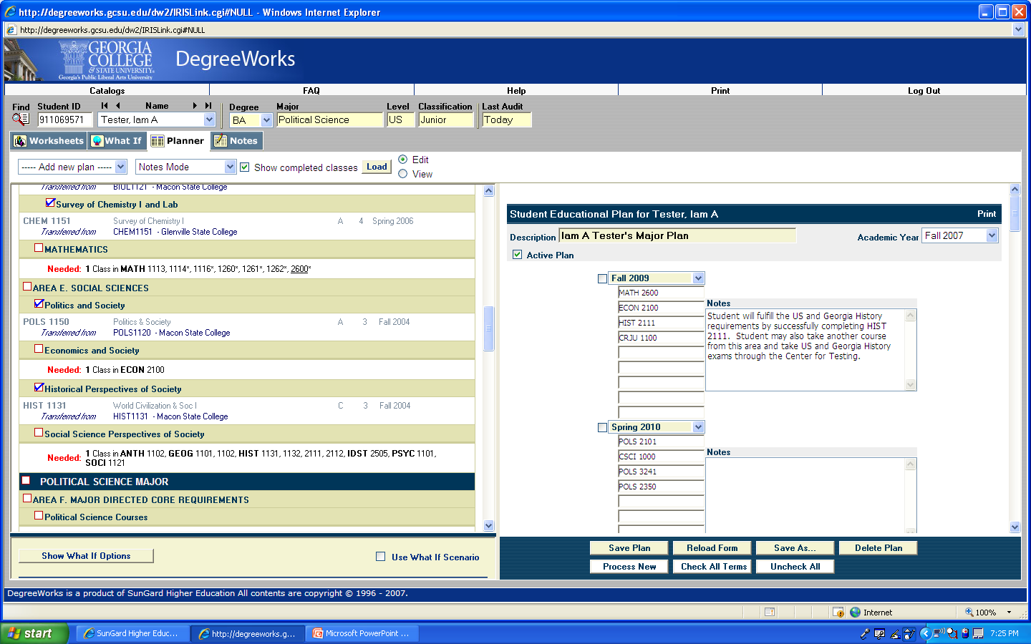
When you have completed entering courses, use the “save plan” button.
(You can also save periodically while you are working if you have several
semesters to enter.)

Slide 40
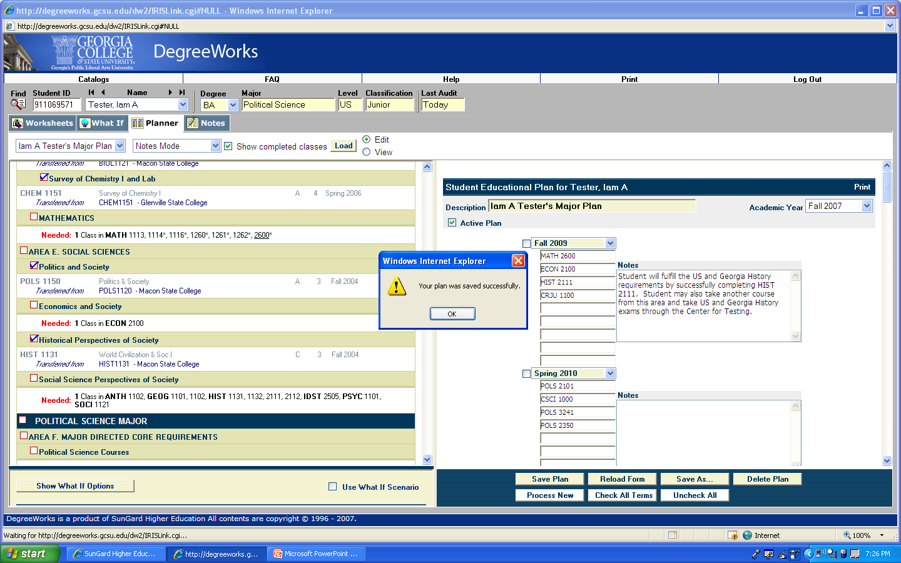
If your plan was saved successfully, a pop up box will appear with this message. If there were any errors, a pop-up box will appear with instructions for correcting those errors.

Slide 41
What is your major?
The remainder of the directions differ
depending on your current major.
If you are currently a “pre-” major
(i.e., Pre-Nursing, Pre-Mass Communication, Pre-Psychology, etc) to continue, follow this link: "Pre"
If you are currently undeclared and want to compile
a plan that includes requirements for a specific major, continue by following this link:
Major Exploration
If you are not a “pre-” major, to continue
follow this link: Major Declared

Slide 42
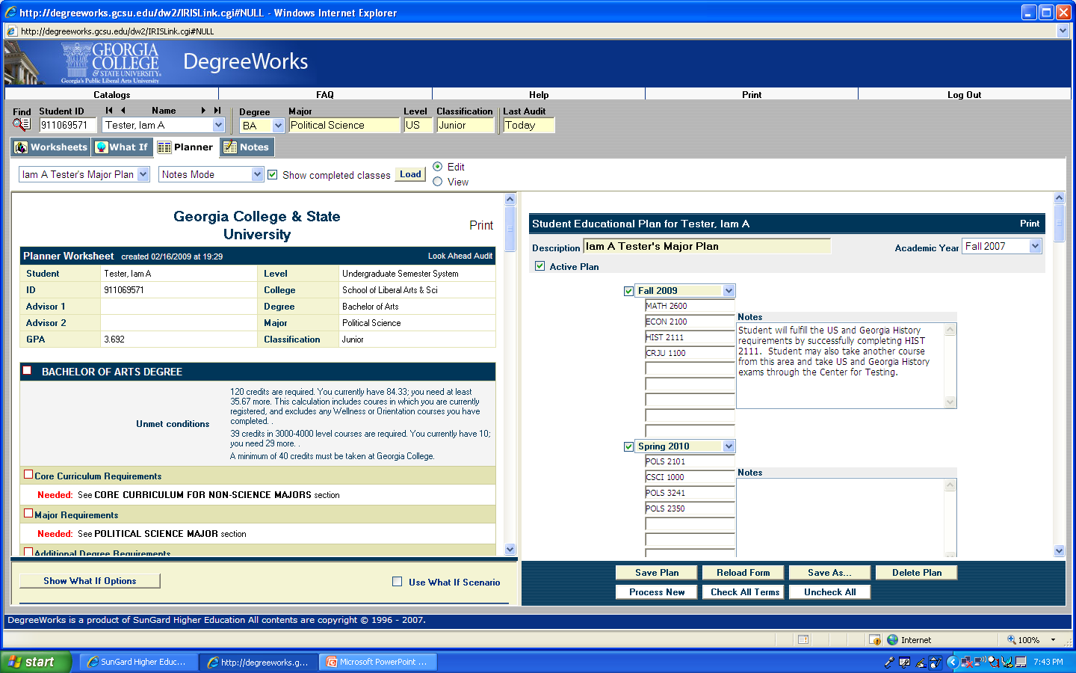
If you are currently a pre- or an undeclared major, you will also need to use the what-if option in the Planner if you want to add course requirements for your intended program.

Slide 43
Click on the “Show What-If Options” button.

Slide 44
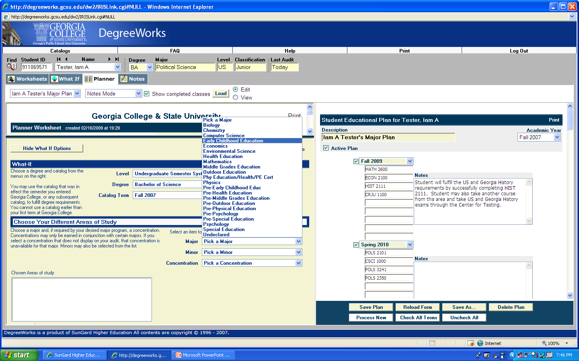
Pick your intended degree and major from the drop down boxes. (For example, if you are currently a Pre-Early Childhood Education major, select Early Childhood Education.)

Slide 45
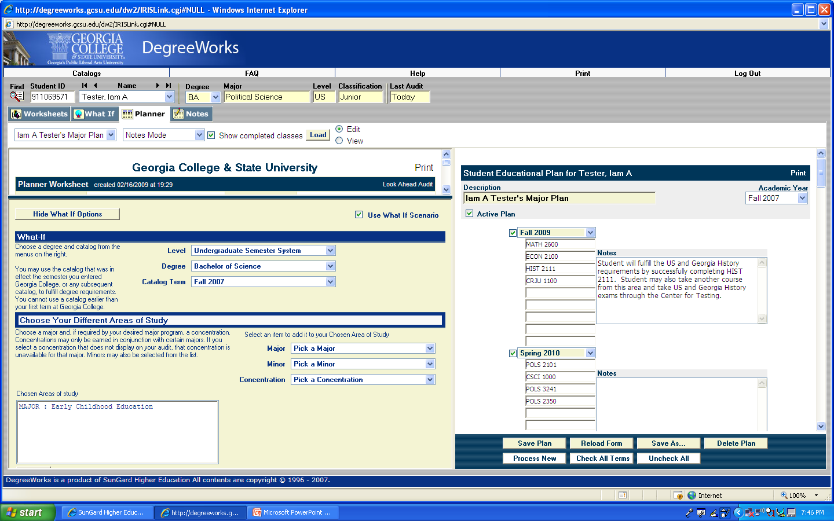
Be sure the “use what-if scenario” box is checked.

Slide 46
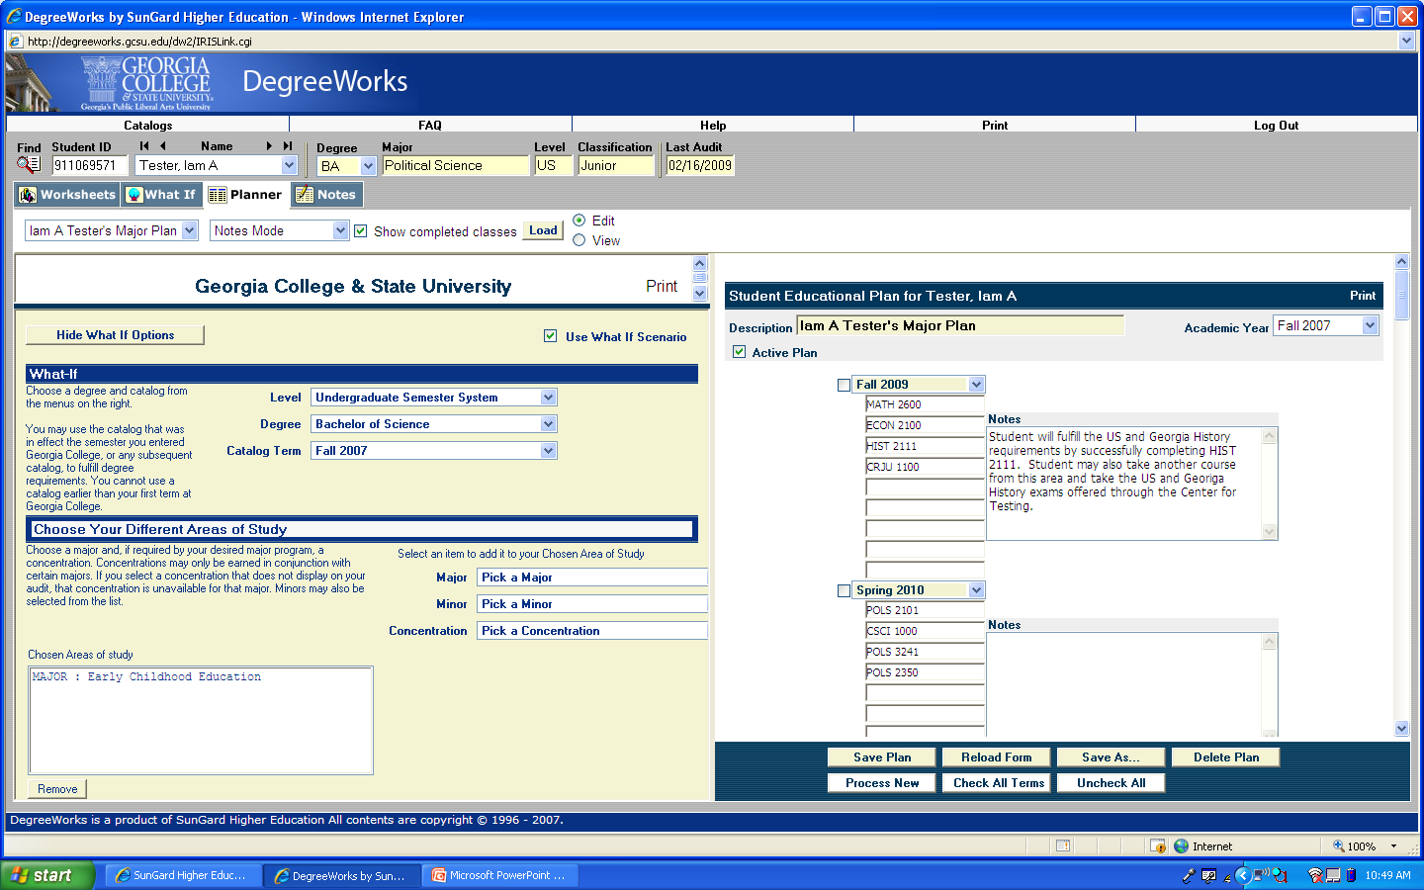
Use the “Hide What-If Options” button

Slide 47
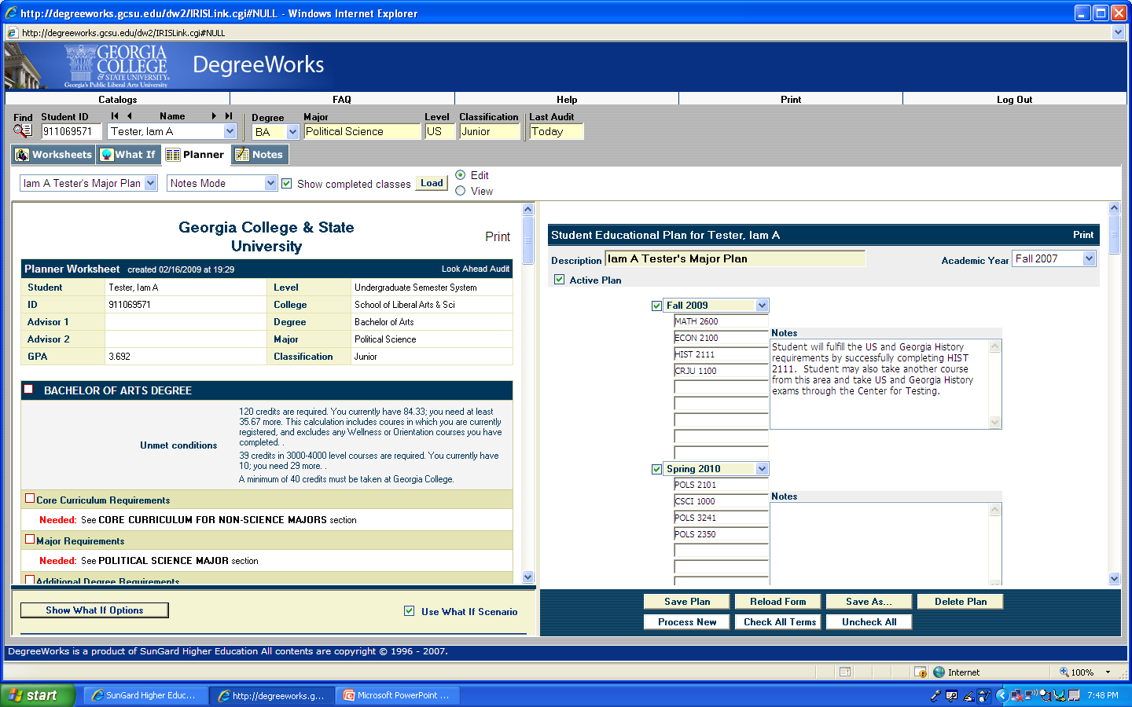
Use the “Check All Terms” button if the boxes by your terms are not already checked

Slide 48
Use the “Process New” option to generate a new worksheet using your intended program. (**This function is distinctly different for other majors who are not part of “pre” programs!)

Slide 49
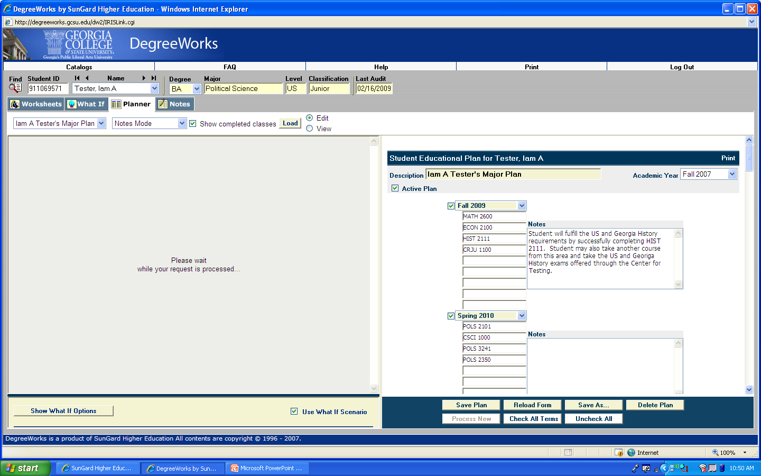
A new worksheet will be generated for your intended major.

Slide 50
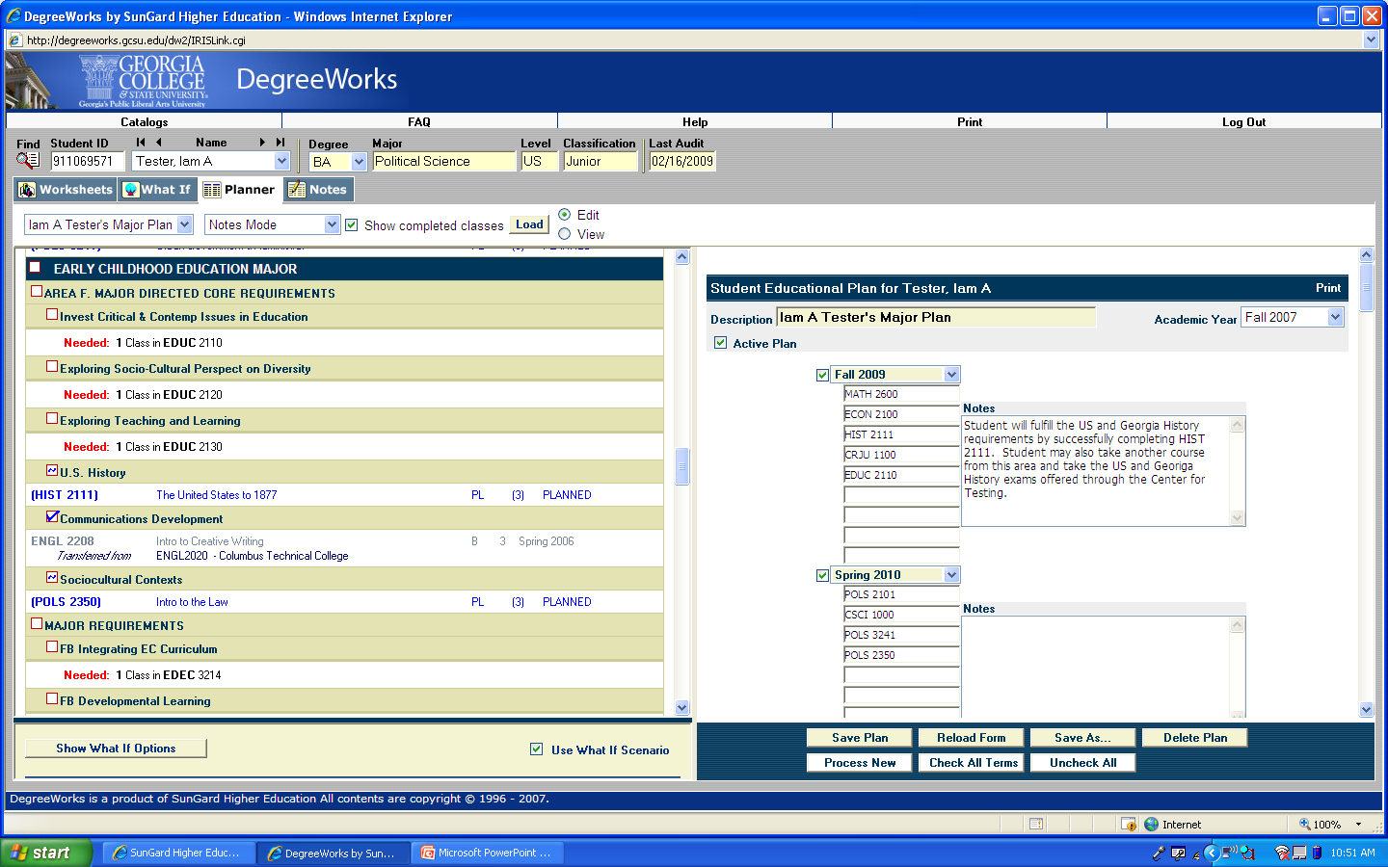
Review the worksheet for your intended major, and then continue to drag and drop needed courses from your worksheet to the available terms on the Planner.

Slide 51
When you have completed entering courses, use the “save plan” button.

Slide 52
Each time you load this plan as a pre-major, you will need to use the what-if scenario to select your intended degree and major, then process a new worksheet. Otherwise, your plan will be evaluated only against your pre-major, and will not be complete.

Slide 53
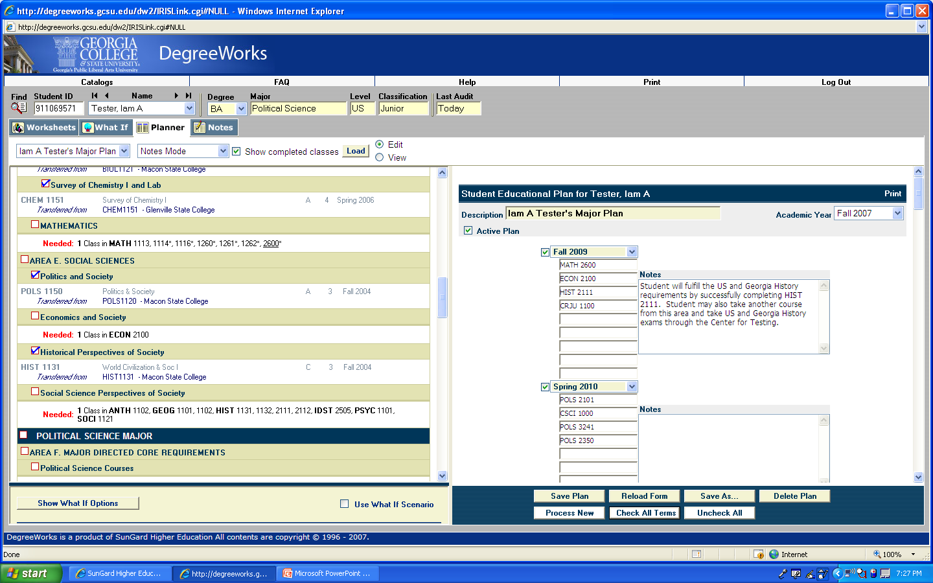
To check your plan, use the “check all terms” button if the boxes by your terms are not already checked. (If for any reason you only want to include some semesters in your degree check, manually select the semesters you want to include.)
.

Slide 54
Use the “Process New” button.

Slide 55
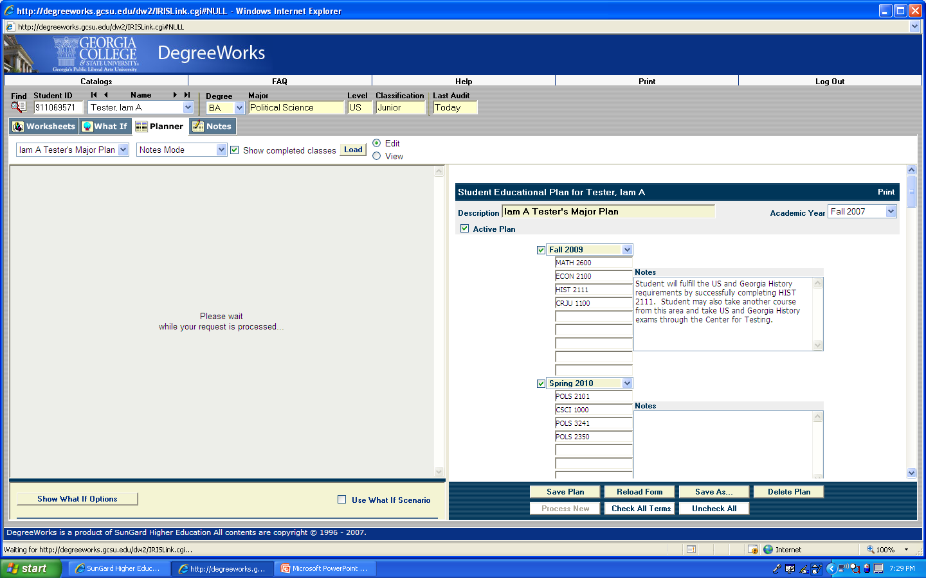
A new worksheet will generate on the left-hand side of the page.

Slide 56
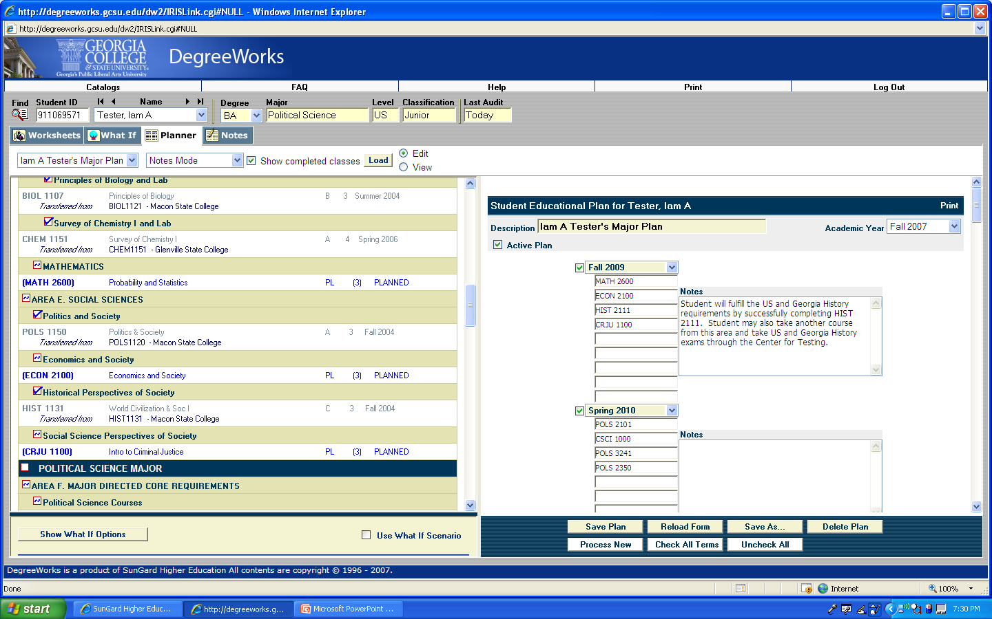
When processing is complete, you will be able to review your worksheet with your planned courses included. Planned courses will be printed in blue.

Slide 57
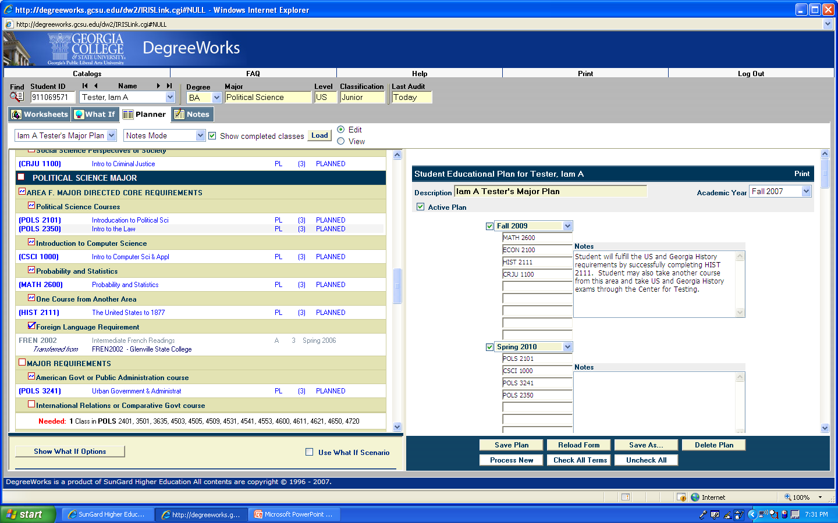
After reviewing this worksheet, if you need to make any changes to your plan, drag and drop additional courses to your plan or manually enter any changes. Then save your plan again, and process a new plan to recheck your work.

Slide 58
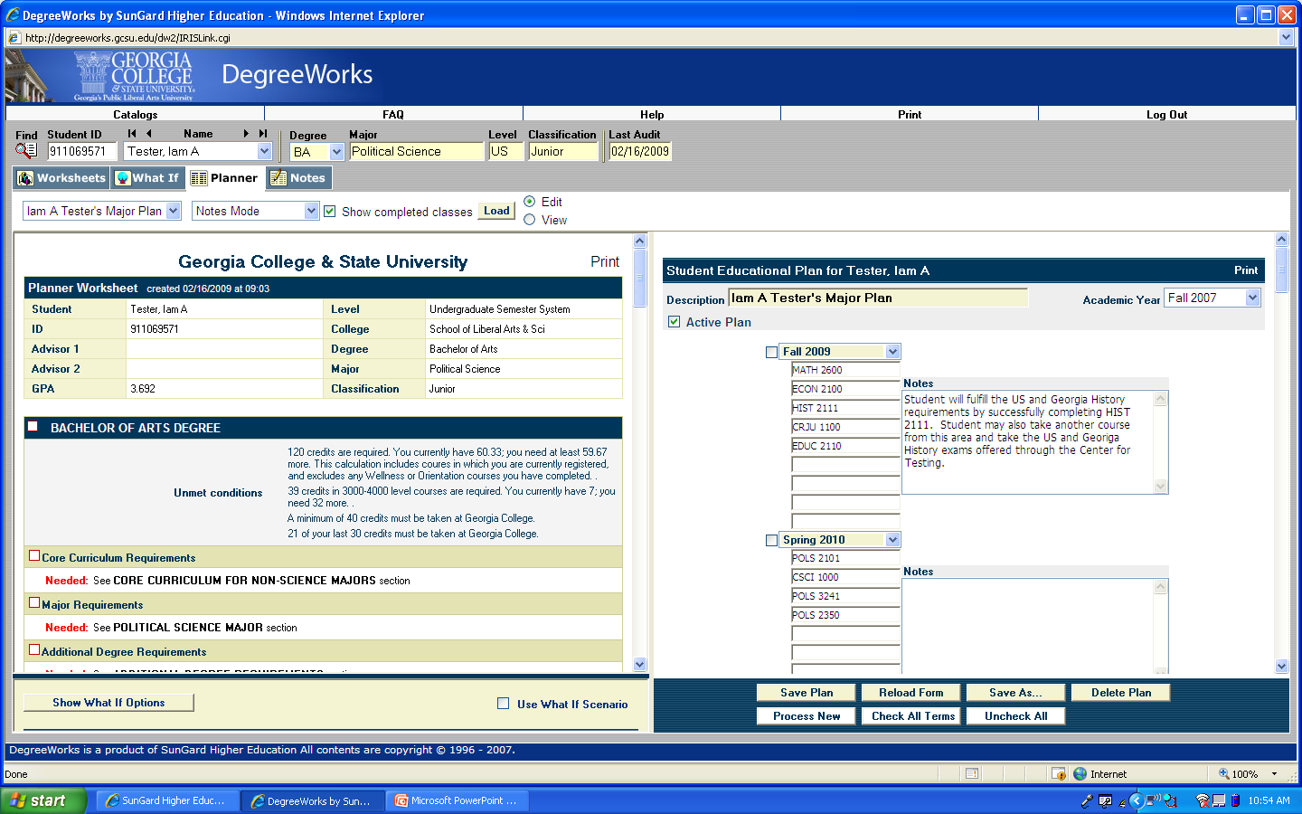
The next time you return to the Planner, this plan will automatically load, and you can view or edit this plan. If you’d like to start a different plan, select “add new plan” from this drop down menu, use the “load” button, and then begin again.

Slide 59
Please note:
You can create as many plans as you’d like, but only one plan at a time can be marked as active. Please designate the plan that most closely matches your intended degree completion plan as active.
If you plan to complete a course at another institution, please do not include it on your plan. Instead, indicate your transient plan in the Notes section.
Be sure to save often.

Slide 60
Next Steps
Review the FAQ Document for more information about the Planner. This document includes specific information about how the Planner works with certain major requirements, and will provide answers to many of your questions.
Review your plan prior to registering to make sure you enroll in all the courses you need.
Update your plan regularly, particularly after registration or after you add/drop a course. Review your plan with your advisor during your next advising meeting.

Slide 61
Registration

Slide 62
Registration
Make an appointment with your academic advisor. All undergraduate students are advised by a professional full-time academic advisor, located in the Advising Center on the second floor of Lanier Hall. Graduate students are generally advised by their program coordinator. Advisors’ schedules fill quickly near registration, so do not wait until the last minute to make your appointment.

Slide 63
Registration
To prepare for your advising appointment, review your DegreeWorks degree audit worksheet. To access your audit, log in to Unify, select PAWS, then:
>Student Service Tab> Student Records> DegreeWorks.
Your audit worksheet will help you:
Identify courses that you need to complete your degree program
Ensure all courses transferred into GC applied as expected
Ensure all registered courses make progress toward degree completion
If you have any questions about courses or requirements, be prepared to ask your academic advisor during your advising appointment.

Slide 64
Registration
Review the course schedule. The course schedule can be found in the PAWS main
menu under Semester Course Schedule. (If you are on the Student Services Tab, you will need to select “Return to Menu” to access this screen.) After selecting the registration term from the drop down menu, you may search for specific subjects, class times, instructors and locations by choosing options in the drop down menus.
Prepare a list of desired courses and alternates. Prepare a list of courses, including
the Course Reference Numbers (CRNs) in which you would like to enroll. The CRN
is the unique five digit number listed for each class, and is the number you will need to register. Each course section has one CRN. Fall course CRNs begin with the number
8. Spring course CRNs begin with the number 2, and Summer course CRNs begin
with the number 5. Be sure to also select alternate courses and times.

Slide 65
Registration Review:
Find your registration time. Your registration start time is determined by your current class standing and does not include hours in which you are currently registered.
Currently enrolled students will receive an email with their registration time via their bobcats email. You can check your registration time by logging into Unify, and then selecting PAWS, Student Services, Registration, and Registration Status. You may also check the academic calendar for specific registration times.
Registration occurs in mid-March for the Summer and Fall terms and in late October for the Spring term. Registration follows the schedule listed on the next slide, beginning each day at 7 a.m.
.

Slide 66
Day 1: Graduate students, seniors (undergraduate students with 90+ earned hours), and approved priority registration students
Day 2: Juniors (undergraduate students with 60-89 earned hours)
Day 3: Sophomores (undergraduate students with 30-59 earned hours)
Day 4: Freshmen (undergraduate students with 0-29 earned hours)
Students are strongly encouraged to register at their first available registration time to ensure the best selection of courses.
Amendment 23 and TAP (USG Tuition Assistance Program) students may register only on a space-available basis. Your registration time begins one week before the beginning of the semester

Slide 67
Check your registration holds.
Certain holds, including immunization, parking, and
library holds, may prevent you from registering for classes. Your hold status can be viewed by logging into Unify, and then selecting PAWS, Student Services, Student Records, View Holds. Holds that block registration will include the word “Registration” in the “Processes Held” column; a hold of “Advising Hold Temporarily Released” does not prohibit registration.
If you have any questions about your holds, contact the office listed on each hold description. The number listed next to the hold is the office phone number; all Milledgeville campus phone numbers begin with 478-445-xxx. Do not wait until the last minute to clear a hold; most holds take 24 hours to clear and can only be resolved during business hours.

Slide 68
Keep Your Appointment with Your Academic Advisor.
At Your Registration Time
Log In a Few Minutes before Your First Available Registration Time. Registration begins precisely at 7 a.m. each morning and tends to end quickly. In order to get your choice of classes, be sure you are logged in to Unify and PAWS before the 7 a.m. registration start time and that you are ready to go the second registration begins.

Slide 69
Before the start time, log in to Unify, then select PAWS, Student Services, and then Registration.
Register. Select the term for which you are registering. (If you are registering for summer and fall and your summer courses are prerequisites for fall courses, you should register for summer first.) Then select Add or Drop Classes. Once your registration time begins, this link will take you to the screen where you can enter your desired CRNs or search for additional class options. Enter your CRNs and then click submit. Be sure to carefully review the next screen, which will either confirm your registration or give you a registration error.

Slide 70
If you need assistance with errors that occur during your registration process, click on the Resolving Errors during Registration link on the Add/Drop courses page or consult the Resolving Registration Errors document on the Registrar’s Office web site for additional instructions.
If a class is closed and has a waitlist then a drop down box will appear. Change the course status to waitlist and click submit to reserve a spot on the waitlist. Be sure to review the information about wait listed courses so you know how to accept a seat if it becomes available and how to sign up for text message alerts.

Slide 71
Immediately After Registration
If Needed, Research Additional Schedule Options. If you do not get your preferred schedule or a complete schedule on your first attempt, use the following strategies to complete your schedule:
Look for other sections of the same course that are still open. You may need to take a class at 8 a.m. when you’d really prefer 9 a.m. or take a class with a different professor than the one you planned to take.

Slide 72
Look for other courses that fulfill the same requirement. For instance, in Area C of the core, an undergraduate can not only use ENGL 2110 and PHIL 2010, but also AFST 2010, BLST 2010, IDST 2305, and RELI 1111. You can wait list one section of every course to better your odds of receiving a seat that fulfills a certain requirement.
Look for other courses that you need to complete, and, if you do not need additional prerequisites, register for those courses instead.

Slide 73
Wait list desired courses if that option is available. Departments often use wait lists to determine the need for additional sections or seats, so this is the best way to record your desire to take a specific course.
Assess your position for any courses for which you are wait listed. If your wait list position is higher than 10, you definitely need to have some other
options secured as soon as possible.
As an undergraduate, you are not finished registering until you have a full-time
schedule of at least 12 hours (15 hours preferred).

Slide 74
Review Your Schedule. Double-check your schedule by clicking on the GCSU Printable Schedule on the Registration menu. This will help you ensure that no mistakes were made during the registration process.
Review Your DegreeWorks Degree Audit Worksheet. Make sure that all the courses that you registered for are counting toward your degree in the way you intended. If you have questions after reviewing this information, consult your academic advisor or the Registrar’s Office.

Slide 75
After Registration
After your schedule is finalized, visit the Student Account Center to pay for your courses. You are not officially enrolled in your courses until your account is paid in full. The payment deadlines are posted on the academic calendar.

Slide 76
3. True or False: When in Unify, you must select the PAWS tile to access registration and DegreeWorks.
True or False

Slide 77
Congratulations!!
Please continue the Module

Slide 78
Sorry !
Try again!

Slide 79
Please watch Registration Tutorial
https://www.youtube.com/watch?v=6GPgJbwr_8Q

Slide 80
Contact Information
Registrar's Office
Georgia College
Parks Hall 107, Campus Box 069
Milledgeville, GA 31061
Office: 478-445-6286
Fax: 478-445-1914
Email: registrar@gcsu.edu

Slide 81
LIVETEXT

Slide 82
What is LiveText?
LiveText is an online program that is
Course management
Portfolio building and management
Projects, lesson plans, resources
Central repository for all of your work
Standards-based
Collaborative
Capability to upload video
Used by everyone enrolled in the JHL College of Education

Slide 83
How do I get to LiveText?
Go to the website www.livetext.com
Click “Register”
On the next screen, click Purchase under Purchase Membership.
Fill in the required information as follow:
Step 1: Enter Your Personal Information
Be sure to use your GC email address for your school email address.
Be sure to choose Georgia College as your institution.
Be sure to use your GCID number where for student ID. This not a option

Slide 84
How do I get a LIVETEXT Account
Step 2 Create Your LIVETEXT Account
Choose a username (firstname.lastname is always easy to remember)
Use any password of your choosing.
Step 3 Select Your Student Membership
Choose the package (LiveText Student Membership Field Experience Edition - $133.00
Non-Field Experience Edition -$115.00

Slide 85
What do I do with it when I get it?
Your professors will require you to use LIveText in different ways. You receive further information and instructions as you begin your courses each semester. It is important to note that you will need to use the browser FireFox to most optimally run LiveText. This is available as a free download a http://www.mozilla.com/en-US/firefox.html. While LiveText will run using other browsers, you will most likely encounter problem if not using FireFox.

Slide 86
Where can I get help if I am having trouble either registering or using LiveText?
LiveText has wonderful online and in-person( via phone) technical support. They can help your through any question or problem. Also, the LiveText coordinator Ruby Griffin here in the College of Education is readily available to assist as well.
Mrs. Ruby Griffin, ruby.griffin@gcsu.edu, 478 445-7368

Slide 87
Georgia View
Getting Started with GeorgiaVIEW

Slide 88
Step 1: Access http://unify.gcsu.edu
Log into Unify using your GC email and Unify password.
If you don’t have a Unify password
Click on the “Forgot My Password” link on left side of the Unify page, or, click the MyPassword tab in the upper right corner of the page.
Click the “Set Initial Password” button on the left side of the screen
Complete the form and submit your password request. If you have any problems creating /changing the Unify password, please contact SERVE at
serve@gcsu.edu or 478-445-7378
Note: If you have not completed your security questions for your account, you will be able to do that after you submit the password and it is accepted. Click “enroll“

Slide 89
Step 2: Access GeorgiaVIEW
After logging in to Unify, click on the GeorgiaVIEW button in the center of the page.
If you have logged in to Unify but cannot access GeorgiaVIEW, contact the Center for Teaching & Learning at
Email: ctl@gcsu.edu
Phone: 478-445-2520
After Hours Help- 1-855-772-0423

Slide 90
Step 3: Access Courses in GeorgiaVIEW D2L
After logging in to GeorgiaVIEW D2L, locate the “My Courses” heading on the home page of GeorgiaVIEW.
From the list provided, find your course. NOTE: Courses are not found under the “My Courses” heading until the first day of the semester.
To Access your course, click on the name of your course under the “My Course” heading.
If your course(s) is not showing under the “My Courses” heading, click on the waffle at the top of the page (next to the envelope), and search for your course(s) in the list.
If your course(s) is not showing in the “My Courses” heading, or in the waffle on the GeorgiaVIEW home page, contact the Center for Teaching & Learning at
ctl@gcsu.edu or 478-445-2520

Slide 91
Thank you

