Slide 1
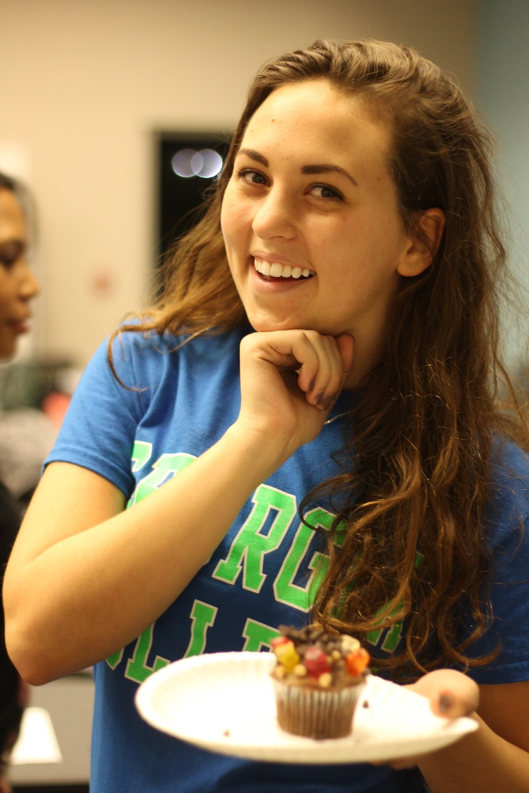
University Housing develops inclusive and dynamic communities where students form relationships that help them grow as engaged citizens.

Slide 2
Why live on campus?
“The greatest benefit is the GC community… a natural system of close encounters between young men and women which stimulate, challenge and influence each other as they share life lessons.”
- John B. Fox Rome, GA

Slide 3
Why live on campus?
Students who live on campus:
More engaged with faculty
More likely to use campus resources
Have higher GPAs
Graduate sooner
Learn time management skills
Live with peers and form new friendships

Slide 4
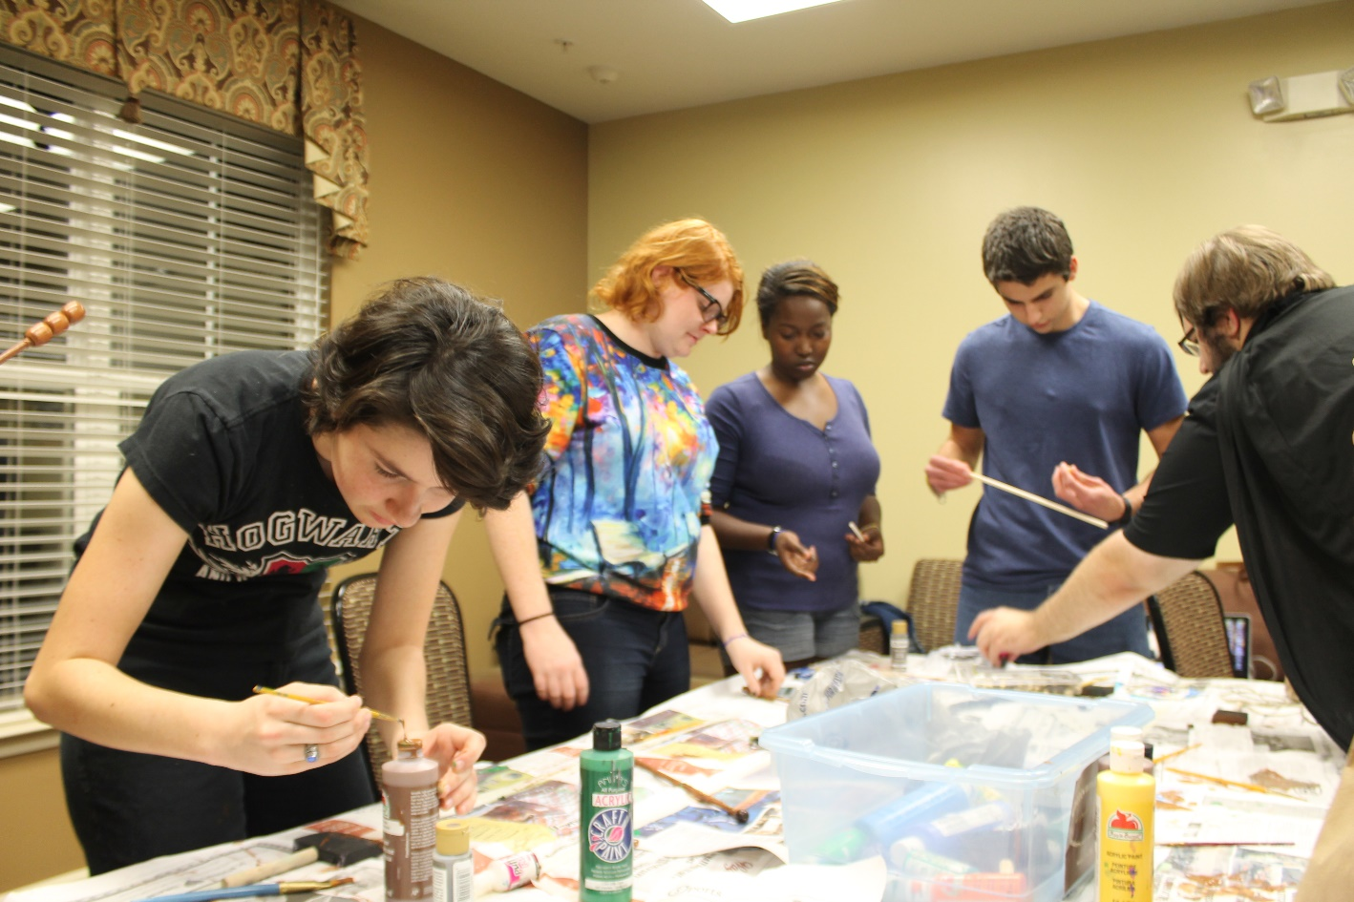
Why live on campus?
Students are in a classroom only 16 of the 168 hours in a week
Getting involved outside the classroom is crucial

Slide 5
Getting Social
Like GCHousing and your hall’s Facebook Page
Follow GCHousing on Twitter and Instagram
Follow Georgia College on Pinterest
Download the GC Mobile App
Participate in Community Council and RSA

Slide 6
Living With a Roommate
Communicate with each other
Make plans over the summer, decide who’s bringing what
Get to know the person, not the Facebook profile

Slide 7
Living With a Roommate
Use the roommate / suitemate agreement to prevent issues
Agreement available online
Our staff is trained to help

Slide 8
Service and Convenience
Convenient parking
Prompt maintenance response
One all-inclusive bill
All utilities (no caps)
High-speed Internet
Expanded cable TV (including HD channels)
Laundry View – email and text alerts

Slide 9
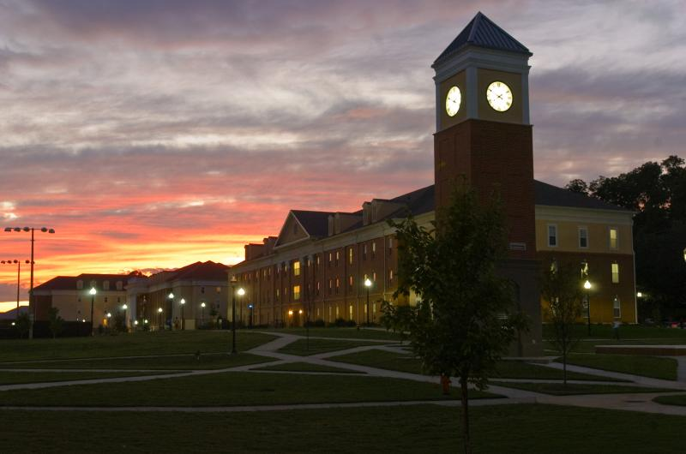
Safety and Security
Public Safety
Card swipe to enter residence halls
Emergency notification buttons
Emergency blue lights
Video cameras

Slide 10
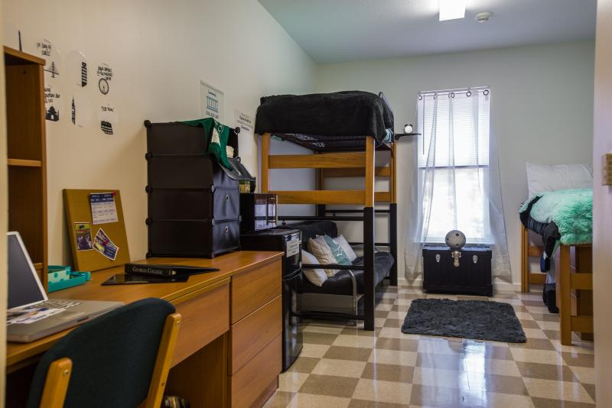
Additional Communications
College Products – Loft and fridge rental
College Avenue -Linen program
SwakU – Care packages
Grad Guard - Renters insurance
Renewal starts in December – First come, first served

Slide 11
We’ll See You on August 16!
Tours available from 12 to 3 at Adams Hall and the Village building 5

